Slide 1
Digital marketing project Work _{On tech Mahindra}
Team details : Team ID: LTVIP2023TMID10448
Team leader: savara. Prameela
Team members : 1.savara. Suseela
2.pedalapu. Rajeswari
3.paidi. Kalyani

Slide 2
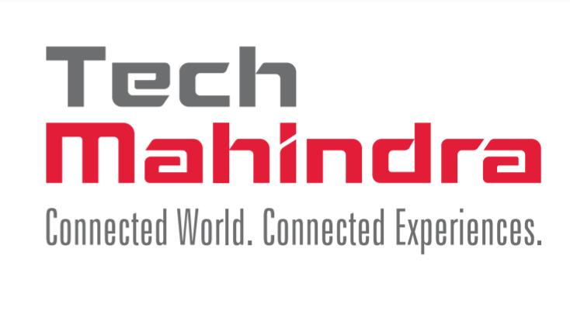
About our project
Topic for project : Tech Mahindra
Research brand identity:
Brand logo :
Brand colour : black, red

Slide 3
Brand tagline : connected world. Connected experiences.
Brand website : https://www.techmahindra.com/en-in/
About the Logo of tech Mahindra :
The tech Mahindra logo Is a wordmark with two colours.
The logos wordmark is a fully customised font and is completely unique to us it has mild serifs that give it a structured, classic, sophisticated feel.
The horizontal version of our logo is preferred for all applications.

Slide 4
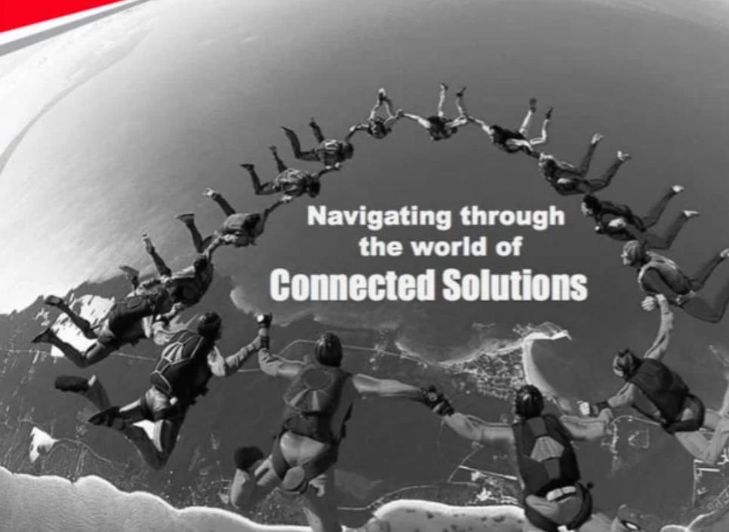
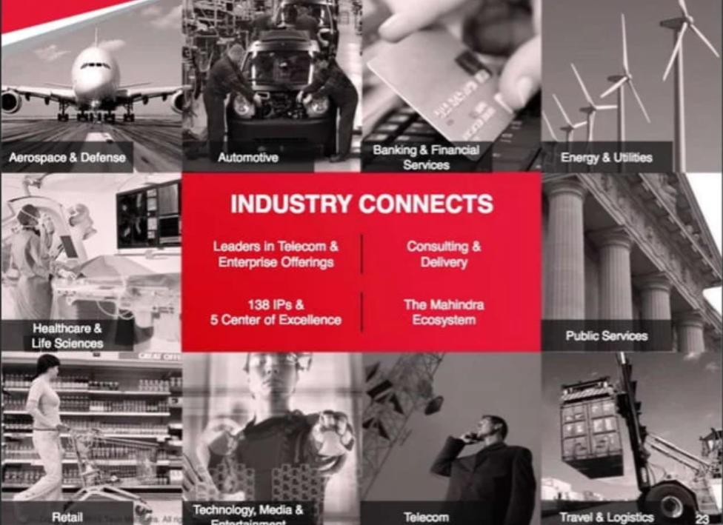
Tech Mahindra Connected world. Connected experiences.

Slide 5
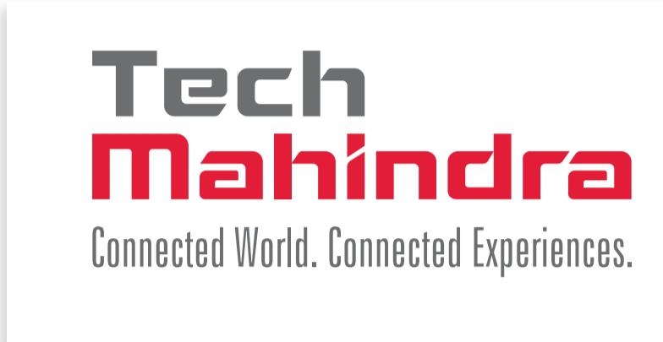
Brand study ,Competitor analysis & buyers persona
Research brand :
Tech Mahindra, part of the Mahindra Group, is a multinational IT and business process outsourcing company which was the highest ranked non-U.S. company in the 2018 Forbes Global Digital 100 list. Find out about Tech Mahindra's science-based targets here.
Mission : Tech Mahindra’s core mission is cantered around driving digital transformation and fostering innovation for businesses across various industries.

Slide 6
Values :
Customer First: Tech Mahindra puts the customer at the centre of everything they do, striving to exceed expectations and deliver exceptional service. Integrity: Tech Mahindra operates with the highest ethical standards, promoting transparency, honesty, and accountability in all business dealings. Teamwork: Collaboration and teamwork are key to Tech Mahindra’s success, fostering a culture of inclusivity, respect, and support. Professionalism: Tech Mahindra values professionalism in all aspects of their work, from communication to quality of service, ensuring that they deliver the best possible results. Social Responsibility: Tech Mahindra is committed to making a positive impact on society, promoting sustainability, diversity, and community engagement.

Slide 7
U s p : Leading IT solution provider in the telecom vertical
Brand tone & identity :
We are an enterprise driven by our promise to deliver Connected Experiences for the Connected World.
We thrive on Change to create a better future for our customers, partners, associates, and stakeholders.
Change that empowers us to innovate, collaborate and care.
We are change makers who are committed to create a positive impact on businesses, communities, and the planet.

Slide 8
K p i & smart goals : SMART goals analysis strategy stands for – Specific, Measurable, Attainable, Realistic, and Time Bound goals. Two of the biggest challenges that companies such as Tech Mahindra faces in today’s uncertain business world are – Setting unrealistic goals that look good on the strategic document but hard to attain in Technology industry. Second – setting the bar too low, leading to under-utilization of the resources at Tech Mahindra disposal. To overcome both of these scenarios, we suggest Tech Mahindra to use the SMART goals strategy.
Buyer’s /audience persona:
Customer satisfaction on all self-service channels like websites, mobile apps, internet, etc.
User engagement and brand loyalty with well designed products and service
Competitor analysis : 1.Hexaware technologies
2.Wipro limited
3.Infosys
4.HCL tech & TCS

Slide 9
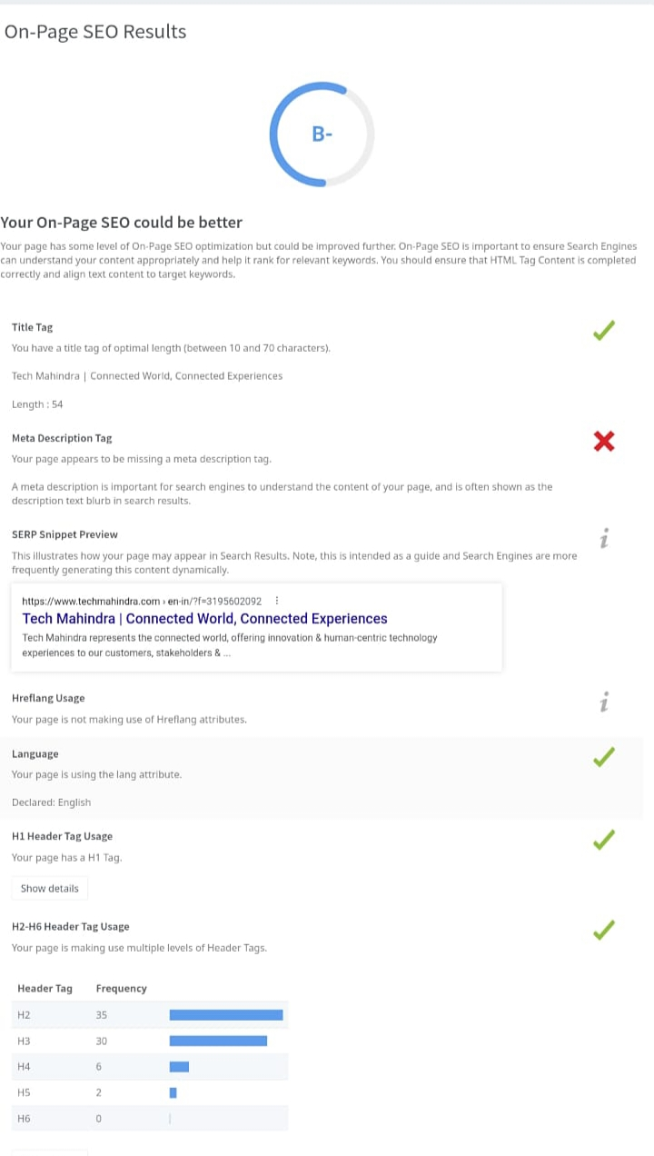
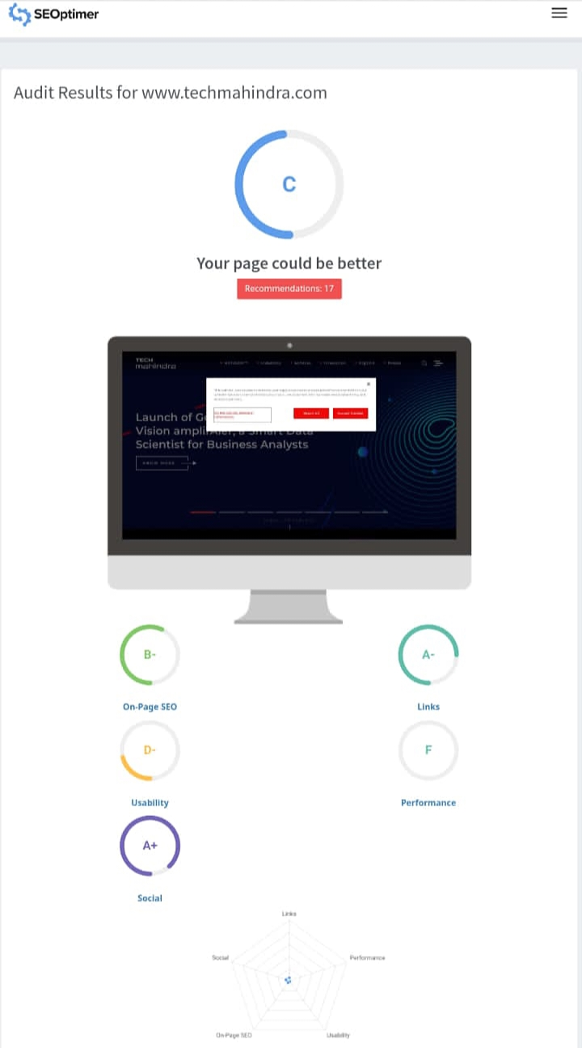
SEO & keyword research : On page seo results:

Slide 10
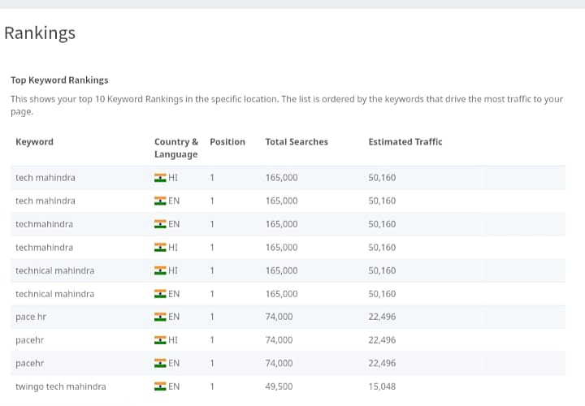
Rankings :

Slide 11
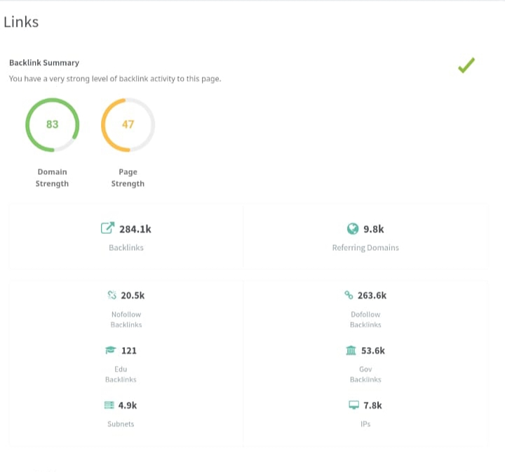
Links :

Slide 12
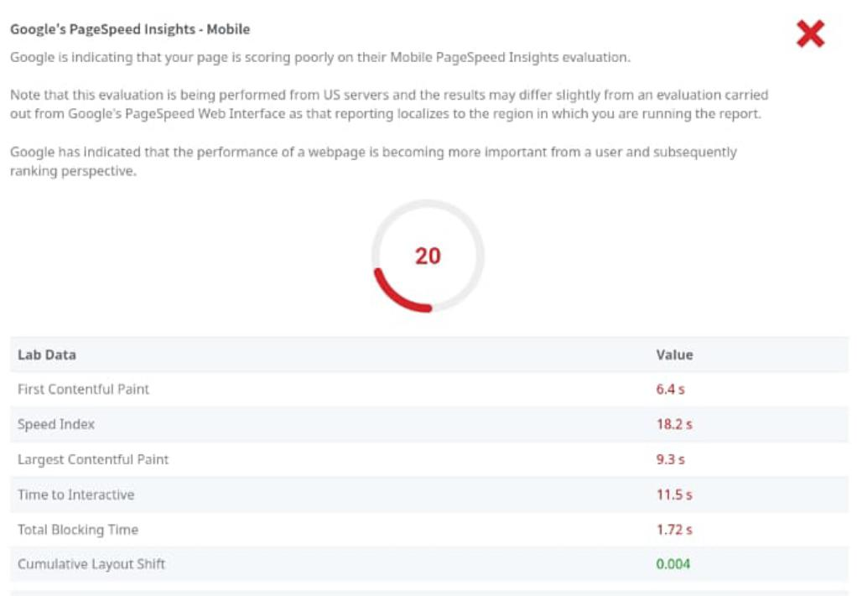
Google page speed insights

Slide 13
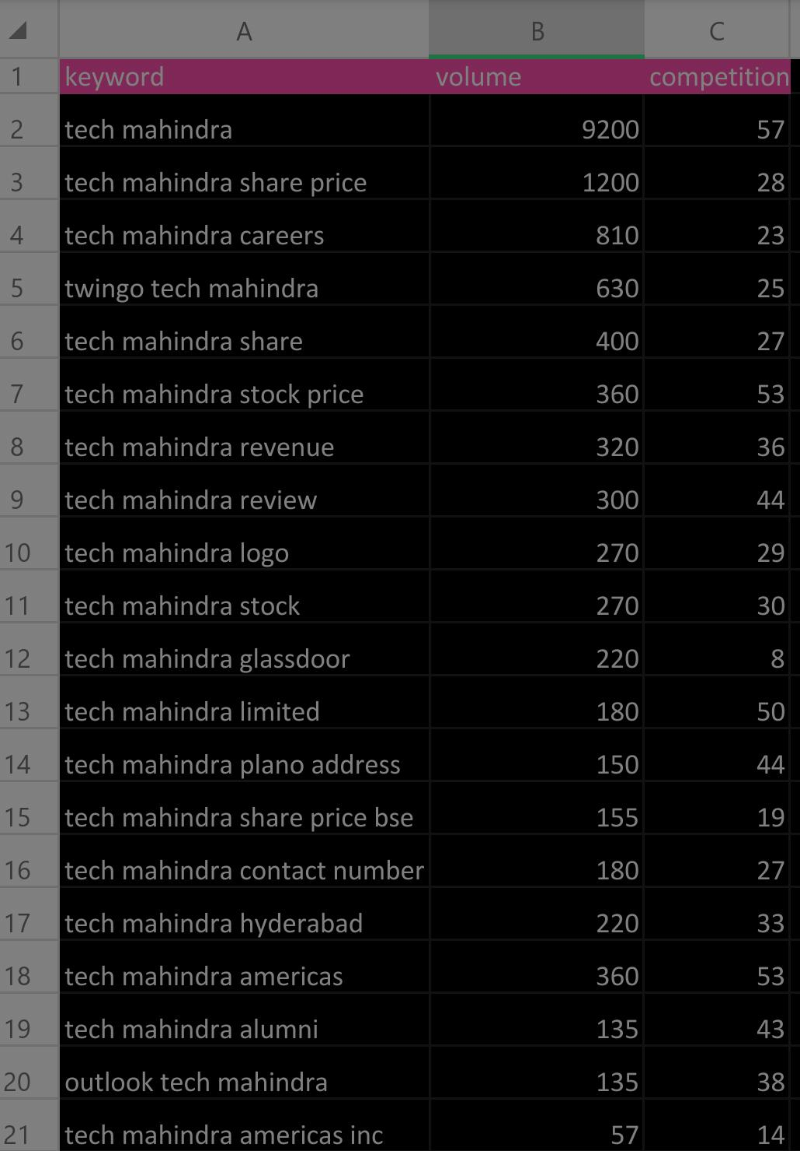
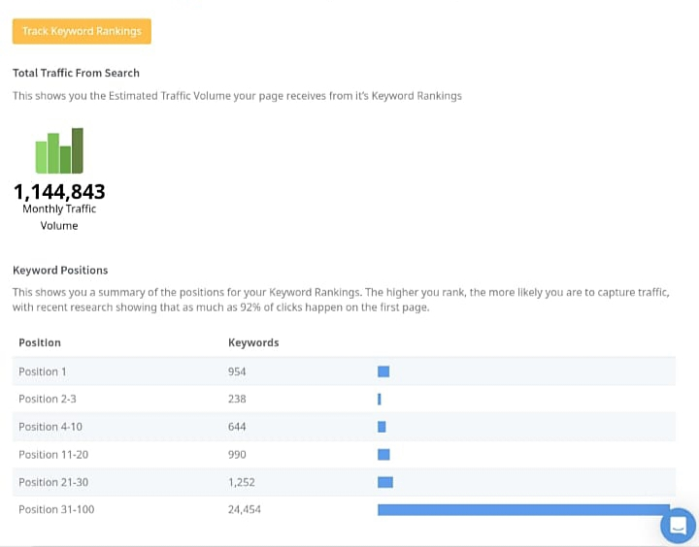
Keyword research:

Slide 14
Content Ideas & marketing strategy:
Tech Mahindra Marketing Strategy & Mix to understand its product, pricing, advertising & distribution strategies : 1. Product Strategy
2. Pricing Strategy
3.Place and Distribution Strategy
4.Promotional and Advertising Strategy
5.Service Strategy
SWOT Analysis of Tech Mahindra: strengths: The strengths of Tech Mahindra looks at the key internal factors of its business which gives it competitive advantage in the market and strengthens its position.

Slide 15
Tech Mahindra Weaknesses: 1.Increased interest costs due to borrowings for Satyam acquisition. 2.High retention
The weaknesses of a brand are certain aspects of its business which it can improve.
Tech Mahindra Opportunities:
1.Increased in demand for IT solution in telecom service provider 2.Acquisition of Satyam telecom gives visibility in more verticals
The opportunities for any brand can include prospects of future growth.
Tech Mahindra threats: 1.Economic slowdown and uncertainty in USA and Europe respectively 2.Increasing presence of foreign IT player in that domain 3.Potential negative impact of Satyam related litigation The threats in the SWOT Analysis of Tech Mahindra are as mentioned above. The threats for any business can be external factors which can negatively impact its business

Slide 16
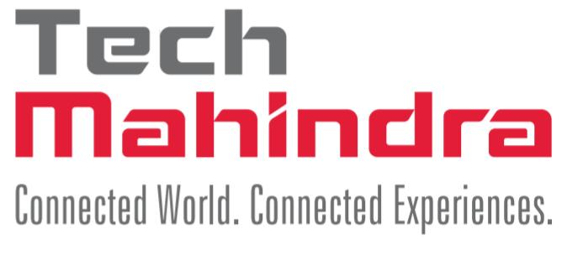
Trending news of tech Mahindra :
Tech Mahindra introduces Green Transportation for
Employees in Noida:
Tech Mahindra has introduced electric vehicles .That will run
five trip daily , covering a radius of 250 green kilometers per day and
saving up to 13,500 litres of fuel monthly, thus avoiding
Greenhouse gas emissions.
Gati partners with Tech Mahindra to develop app to boost productivity,unlock new business opportunities:
Tech Mahindra will enable Gati,over the next18-24 months, to custum develop the software application Gati enterprise management system (GEMS)2.0 from scratch, covering the entire first,mid and last-mile operations, the company said.

Slide 17
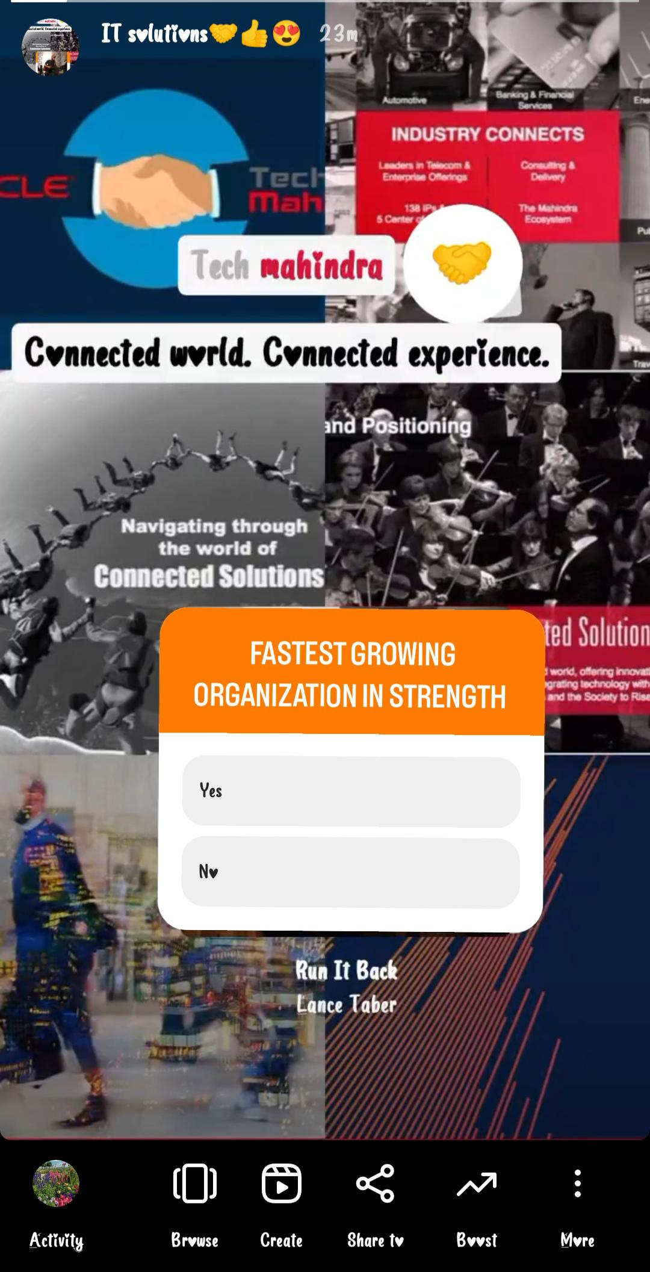
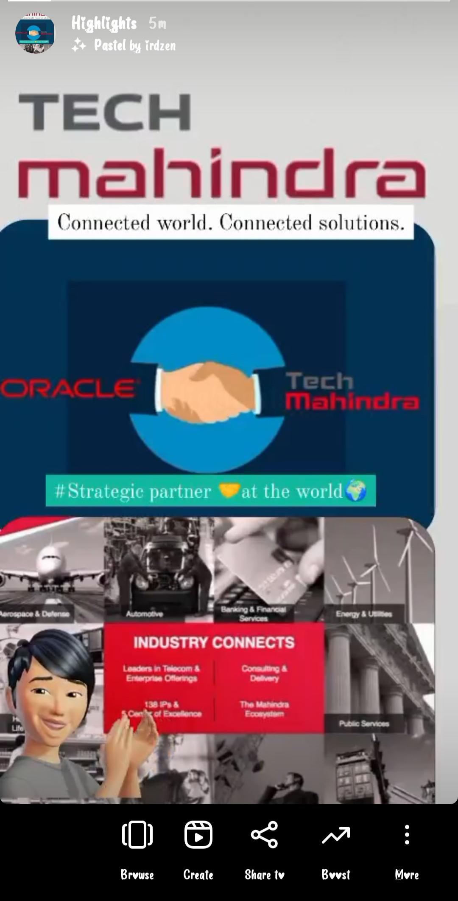
Instagram story
Instagram story link: https://www.instagram.com/s/aGlnaGxpZ2h0OjE3OTQ4MTY0MzUyNTk3NjA0?story_media_id=3211310758164471024_61901805872&igshid=MzRlODBiNWFlZA==
Instagram account link: https://www.instagram.com/invites/contact/?i=d0bik37v6yh5&utm_content=sfqqj3k
Team ID: LTVIP2023TMID10448
Team leader name: savara. Prameela

